Slide 1
MAT-RNN

Slide 2
Introduction
Survival analysis
Need strict assumptions (Independence)
Distributional parameters are fitted
RNN
Model sequential data (complex dependence)
Non-linear association
Point estimate
MAT-RNN
Probabilistic approach + sequence-to-sequence approach
Distributional estimate

Slide 3
Parameters
W_{n} : the time of the n-th arrival
N_{t} : the number of arrivals by time t
Y_{n} : the inter-arrival time of the n-th arrival
tse(t) : the amount of time that has elapsed since the last arrival or start of training period, whichever is smaller
tte(t) : the amount of time remaining until the next arrival or the end of testing period, whichever is smaller
Z_{t} : the remaining time till next arrival conditioned on the current information

Slide 4
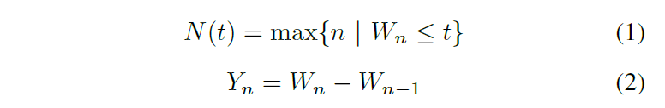
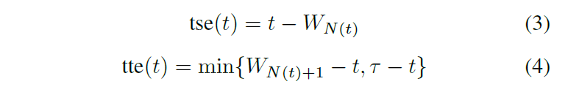
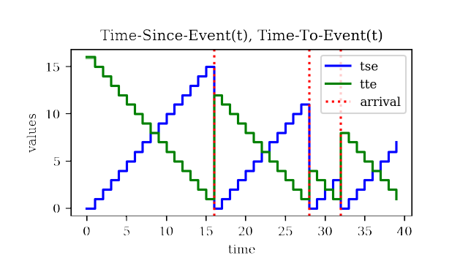

Implementation
By iterating through time for each customer, the RNN outputs sequential distributional estimates for the remaining time until the next purchase arrival, giving a personalized demand forecast.

Slide 5
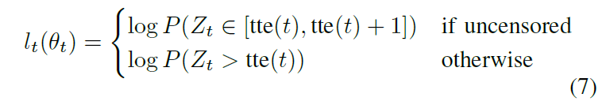
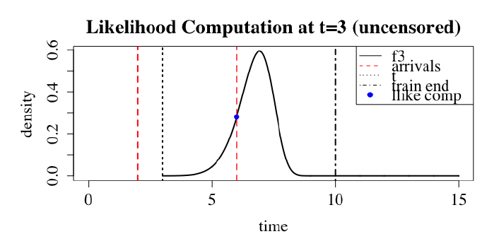
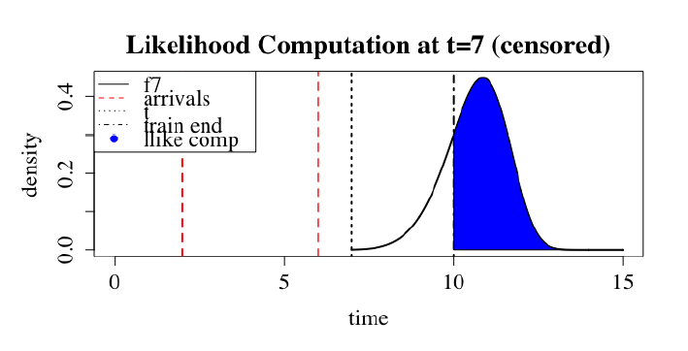

Implementation
RNN outputs the best distributional estimates for the remaining time to next purchase at the end of training period

Slide 6
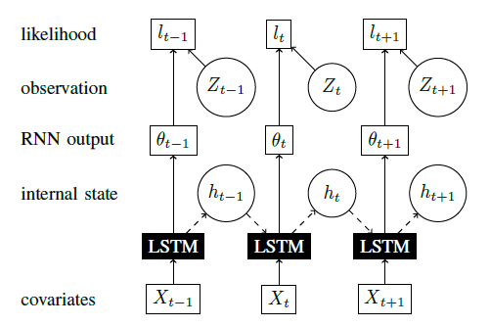
An RNN with distributional outputs
Use LSTM generate θt to compute the log-likelihood function for each time step
ht : the internal state of the LSTM
Xt : the covariates at each time t
θt : outputs generated by an LSTM
lt : log-likelihood at time t

Slide 7
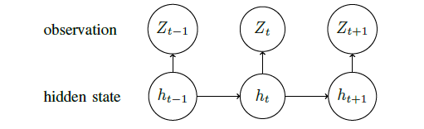
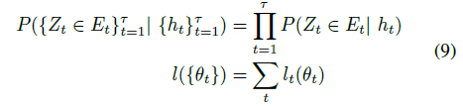

Computing Overall Loss through Conditional Independence
We assume a Bayesian Network similar to a Hidden-Markov model, where random variables at each time t are emitted from a hidden state ht . Thus, we can compute the sum of log-likelihood and distribution function for the entire time. Then, maps Xt to (θt,ht)

Slide 8
Extension to Multi-Variate Waiting Times
To model multivariate arrivals, there several different arrival processes of interest, then, we can get the distribution function for each process.
(In the equation, i means for the i-th waiting time of interest)

Slide 9
Implementation
Masking of Non-Inter-Arrival-Times:
ensures that RNN parameters are not updated due to losses incurred during these times.
Predicting Time to Next Arrival:
we are concerned with the next arrival time after the end of training period (time τ), we can compute many different values of interest.

Slide 10
Application
i-th代表樓層
以MAT-RNN預測各樓層在再來的一段時間內出現有人按電梯的機率
讓idle-car到該樓層待命

